Slide 1
Homophily and Relationship Formation Mechanisms

Slide 2
Where do social ties come from?
Rather than being static social ties are produced via generative mechanisms
  We need to go from network theory
    What networks understood as static infra-structures do
  To the theory of networks
    Processes that account for the formation, maintenance and dissolution of ties
Three general classes of network formation mechanisms
  Assortative
  Relational
  Proximity-based

Slide 3
Where do social ties come from?
Rather than being static social ties are produced via generative mechanisms
  We need to go from network theory
    What networks understood as static infra-structures do
  To the theory of networks
    Processes that account for the formation, maintenance and dissolution of ties
Three general classes of network formation mechanisms
  Assortative
  Relational
  Proximity-based

Slide 4
Where do social ties come from?
Assortative Mechanisms
  Based on the idea that persons seek complementarity or matching on social attributes or ideas, beliefs, tastes and orientations
  Has roots in Lazarsfeld and Merton’s idea of the distinction between “status” and “value homophily”
    Status homophily: Preference to form connections with persons who share socio-demographic attributes
    Value homophily: Preference to form connections with persons who share values and beliefs

Slide 5
Where do social ties come from?
Homophily is one of the most well-established findings in all of the social science
  Has been shown to exist for pretty much every socio-demographic factor we can think of
    Race, gender, religion, ethnicity, nationality, education,
  As well as for various cognitive and cultural factors
Seems to be part of a self-fulfilling prophecy
  People expect similar alters to be more accepting, trustworthy, understanding, etc.
  These are factors that predict less conflict and strain in relationships
  Which lead to stronger more durable relations

Slide 6
Where do social ties come from?
Tendencies toward homophily may be increased in certain contexts
  E.g. where a category is a minority people may be increasingly drawn to seeking similar alters
  Contextually “rare attributes”
    E.g. Blacks in a majority white context such as a business school
      (Mehra et al 1998)
    E.g. Non-believers in a majority religious context such as Notre Dame
      (Sepulvado et al 2015)

Slide 7
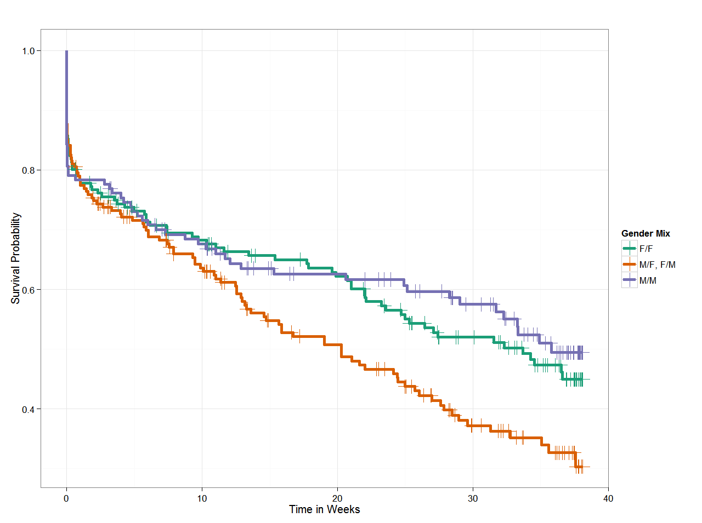
Where do social ties come from?
Heterophily may increase the hazard of relationship dissolution
Homophily may increase the odds of relationship survival
  This seems to be independent of whatever local values are encouraged in the setting
    E.g. “diversity”

Slide 8
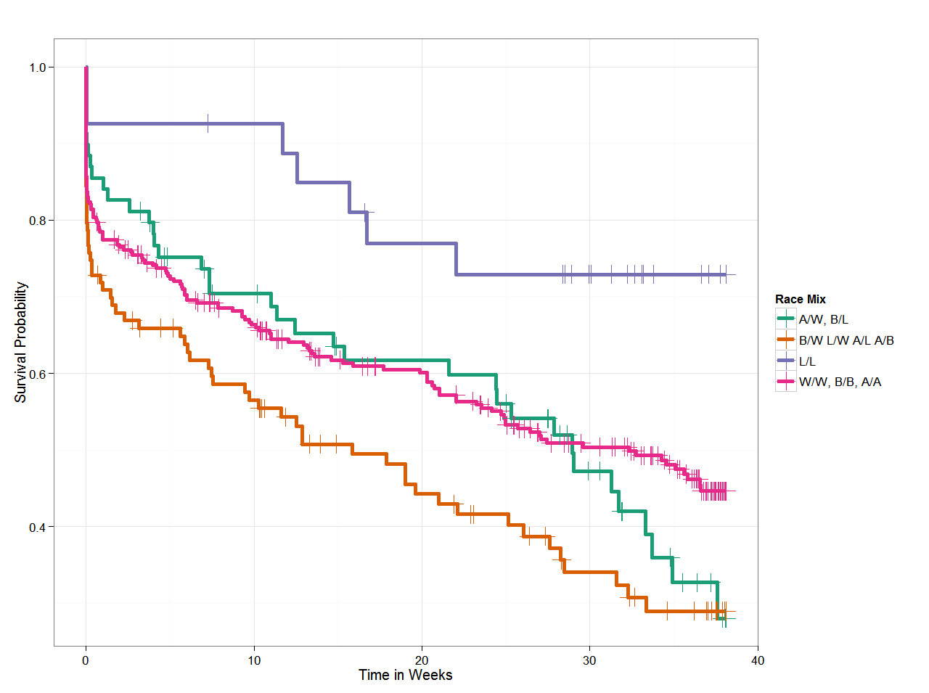
Where do social ties come from?
Heterophily may increase the hazard of relationship dissolution
Homophily may increase the odds of relationship survival
  This seems to be independent of whatever local values are encouraged in the setting
    E.g. “diversity”

Slide 9
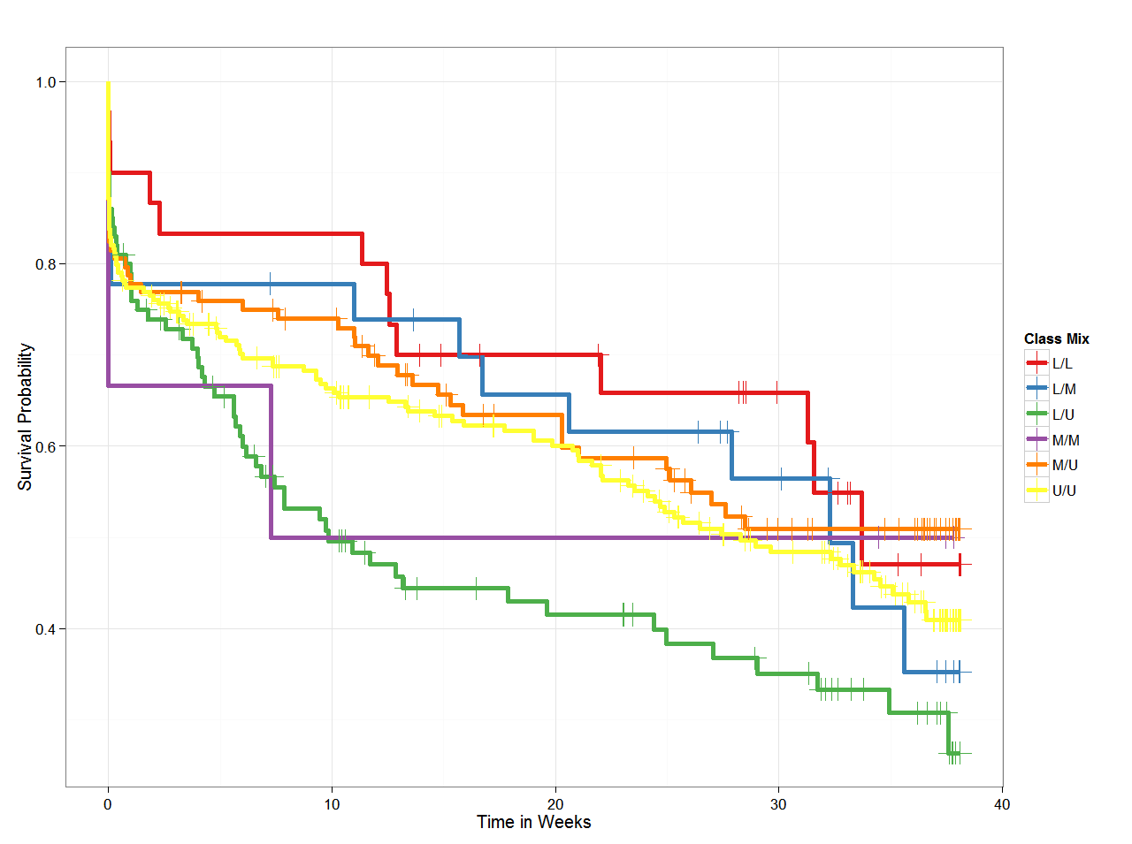
Where do social ties come from?
Heterophily may increase the hazard of relationship dissolution
Homophily may increase the odds of relationship survival
  This seems to be independent of whatever local values are encouraged in the setting
    E.g. “diversity”

Slide 10
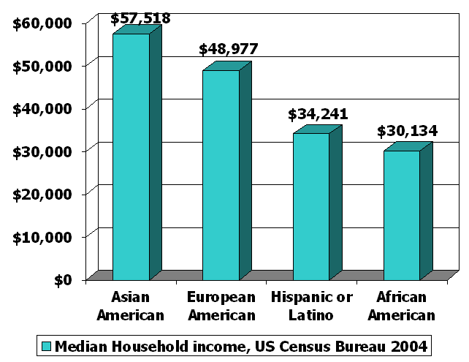
Where do social ties come from?
Flashback: Blau’s Rule of “Multiform Heterogeneity”
  Preferences for homophily in one-dimension may bring heterophily in another dimension
  Depending on the macro-level correlation across dimensions of association
Example:
  In the U.S. Class Homophily among whites may connect them to more asians
  Class Homophily among blacks may connect them to more hispanics

Slide 11
Where do social ties come from?
Flashback: Blau’s Rule of “Multiform Heterogeneity”
  Preferences for homophily in one-dimension may bring heterophily in another dimension
  Depending on the macro-level correlation across dimensions of association
Example:
  In the U.S. Class Homophily among whites may connect them to more asians
  Class Homophily among blacks may connect them to more hispanics

Slide 12
Where do social ties come from?
If homophily is the norm where do diverse arise?
  There are both voluntary (context, coercion) and involuntary (choice) mechanisms
Team-building mechanisms are the most well-studied source of heterophily
  Skill complementarity (you link with others who know how to do things that you don’t)
  Also found in alliances and collaborations
    Science, social movements, industry
  Inter-organizational networks
    “Instrumental” relationships

Slide 13
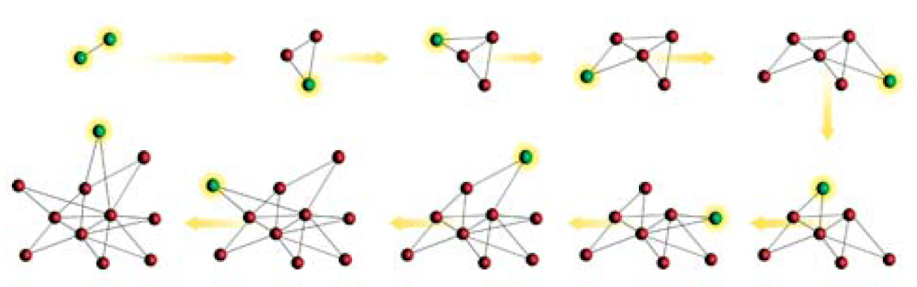
Where do social ties come from?
New ties may appear because actors prefer to connect with certain kinds of others
  “Degree-dynamics” driven by “preferential attachment is the most well-studied version of this phenomenon
    But not the only possible one!
    Any socially desirable feature would do

Slide 14
Where do social ties come from?
In human networks preferential attachment dynamics lead to inequality in popularity and connectivity
  This contrasts with “balance” based dynamics (e.g. closure, reciprocity) which lead to equality
This means that human social networks may be the result of competing dynamics
  One tending towards hierarchy and inequality
  One tendings towards “balance” and equality
People are aversive to inequality but also seek to connect to desirable others (Gould 2002)
  People may add or delete ties at the local level until some equilibrium between these competing dynamics is reached

Slide 15
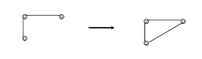
Where do social ties come from?
Where do social ties come from?
  One answer: Inherent tendencies within social networks:
    Clustering, transitivity, or reciprocity
From common relation to relation

Slide 16

Where do social ties come from?
One observation:
  Often social relations are organized around “circles,” or “common activities”
  These “foci” may themselves be a primary driver of which relations show up in people’s networks
What is a “focus”?
  “ a social, psychological, legal, or physical entity around which joint activities are organized (e.g., workplaces, voluntary organizations, hangouts, families, etc.” (Feld 1981: 1016)

Slide 17

Where do social ties come from?
This suggests two new mechanisms for where ties come from:
From circle to relation
From common activity to relation

Slide 18
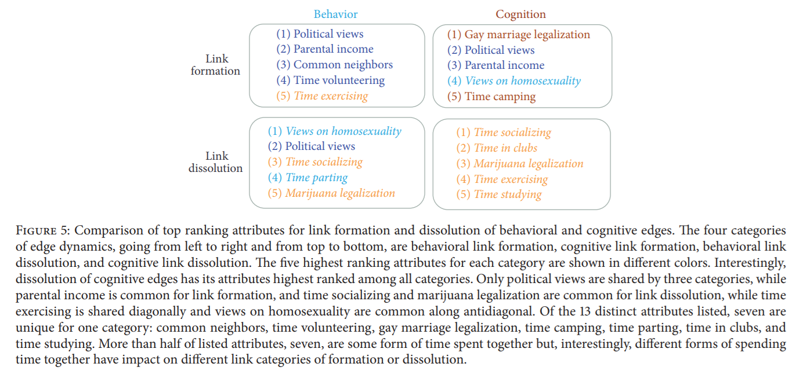
Ashwin Bahulkar, Boleslaw K. Szymanski, Nitesh Chawla, Omar Lizardo, and Kevin Chan, “Influence of Personal Preferences on Link Dynamics in Social Networks,” Complexity, vol. 2017, Article ID 4543563, 12 pages, 2017. doi:10.1155/2017/4543563

Slide 19
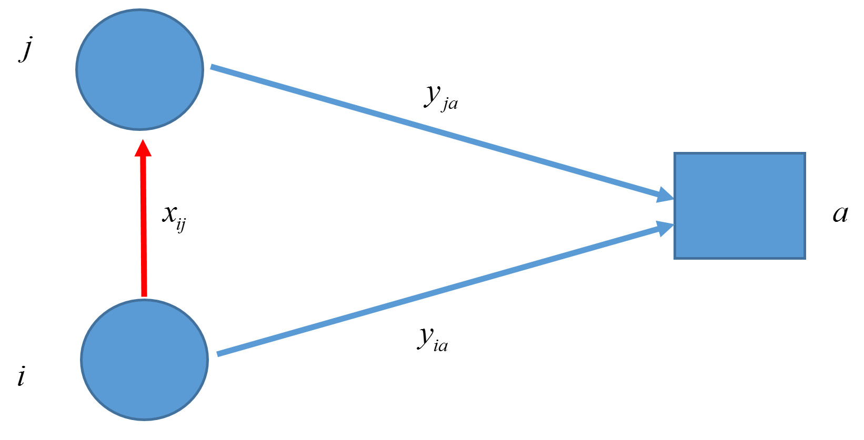
Where do social ties come from?
Next step: Study of the dynamic dependence of structural contexts (circles, foci) and social ties
  Need to keep distinct three distinct patterns of effects:
Memberships affect the probability tie formation
  Classic “Focus” Effect (Feld 1982)
Blue = t_1
Red = t_2

Slide 20
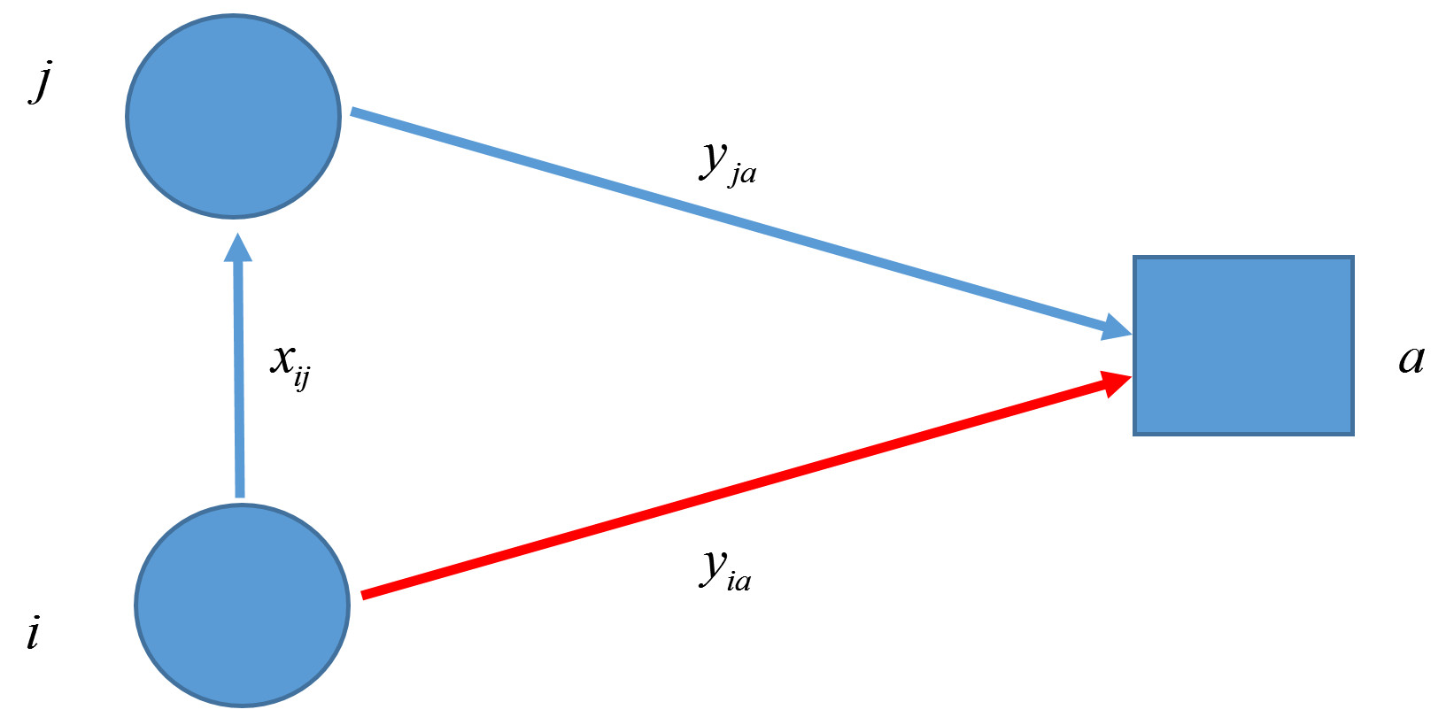
Where do social ties come from?
Next step: Study of the dynamic dependence of structural contexts (circles, foci) and social ties
  Need to keep distinct three distinct patterns of effects:
Memberships “spread” via existing social ties
  Classic “Contagion” Effect
Blue = t_1
Red = t_2

Slide 21
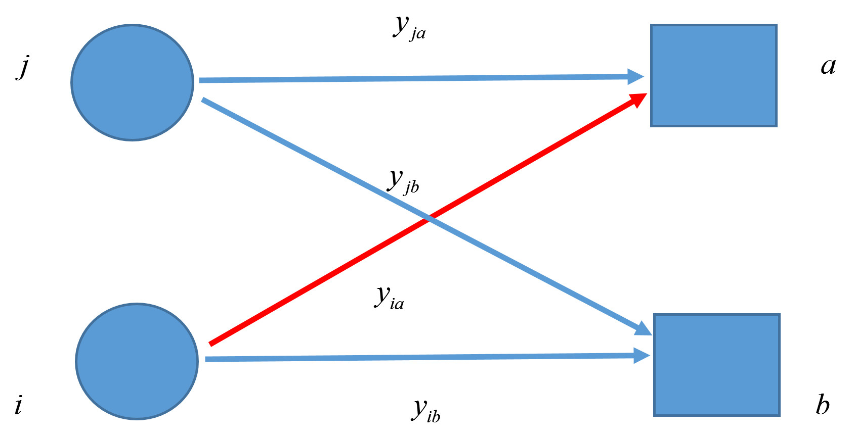
Where do social ties come from?
Next step: Study of the dynamic dependence of structural contexts (circles, foci) and social ties
  Need to keep distinct three distinct patterns of effects:
Memberships “spread” via other memberships
  Focus “Contagion” Effect
Blue = t_1
Red = t_2

Slide 22
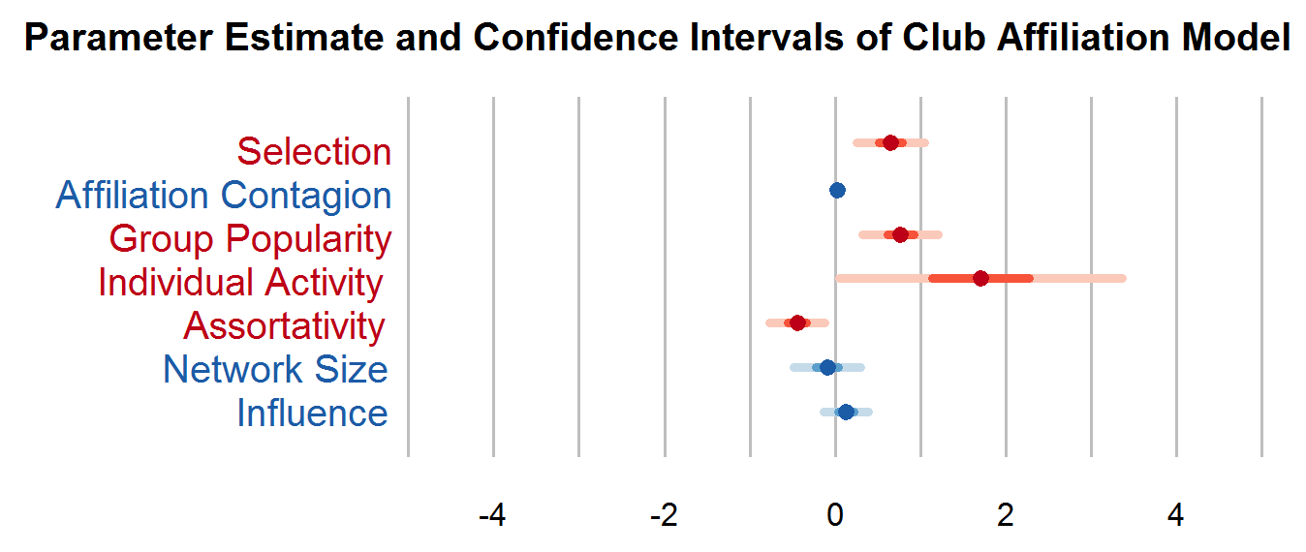
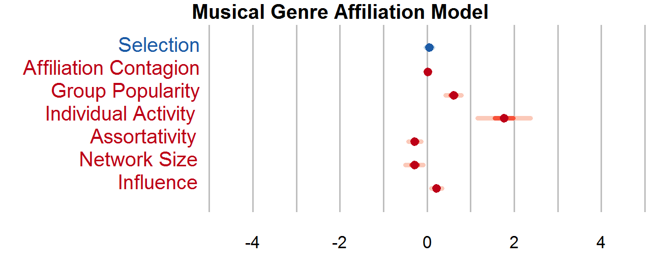
Where do social ties come from?
Some preliminary results from NetSense data:
  Student clubs function as “classic” foci
    They influence tie formation
    But do not “spread” via ties or other clubs
  Cultural tastes do not function like foci:
    They are transmitted via ties
    They are transmitted via other tastes

